Slide 1
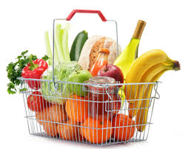
PRESENTED BY
Market basket analysis by apriori algorIthm
SUJIT KUMAR ROUT
Interface Software

Slide 2

contents
Introduction
Machine Learning
Objective
Market Basket Analysis
Association Rule
Procedure(Apriori Algorithm)
Application
Summarization
References

Slide 3
introduction
A large no. of people use to visit shopping malls and shopping centers.
Massive amount of data continuously being collected and stored as transaction.
Market basket analysis in one of the key technique used by large retailers to uncover association between item, and it allows retailers to identify relationships between the items that people buy.
It works by looking for combination of items that occur together frequently in transaction to put it another way, it allows retailers to identify relationships between the items that people buy.

Slide 4
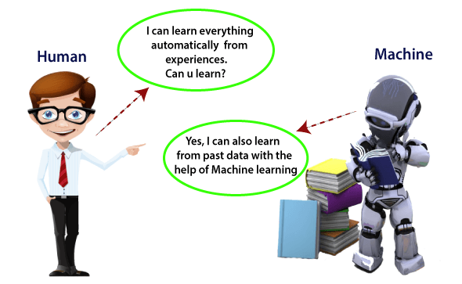
Machine learning
In the real world, we are surrounded by humans who can learn everything from their experiences with their learning capability, and we have computers or machines which work on our instructions.
The term machine learning was first introduced by Arthur Samuel in 1959.

Slide 5
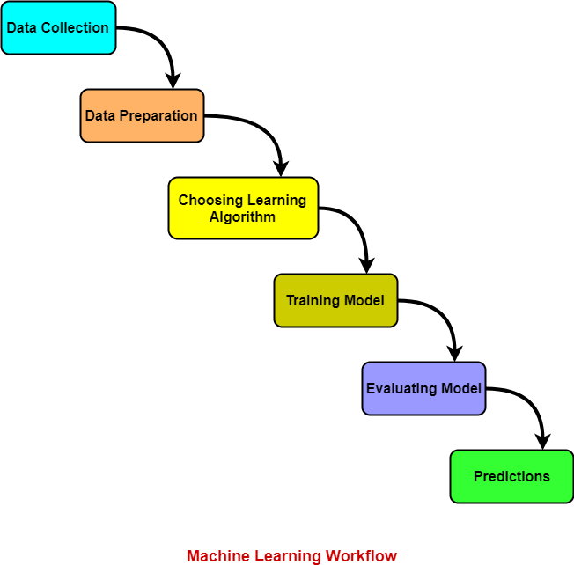
A Machine Learning system learns from historical data, builds the prediction models, and whenever it receives new data, predicts the output for it.
How does Machine Learning work

Slide 6
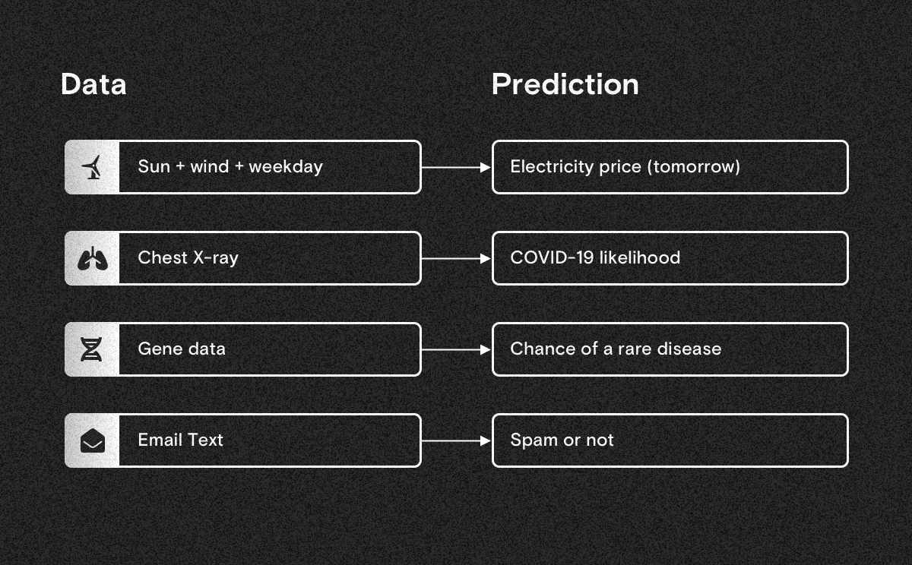
Machine learning finds patterns in data
Simply, machine learning finds patterns in data and uses them to make predictions.
Whenever you have large amounts of data and want to automate smart predictions, machine learning could be the right tool to use.

Slide 7
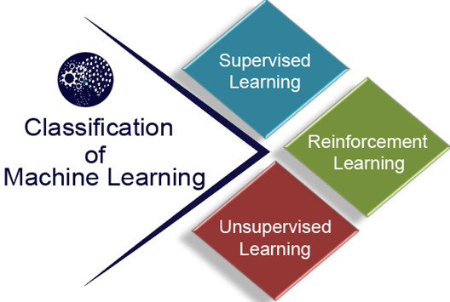

Slide 8
Supervised Learning:-
Supervised learning is a type of machine learning method in which we provide sample labeled data to the machine learning system in order to train it, and on that basis, it predicts the output.
Supervised learning can be grouped further in two categories of algorithms:
Classification
Regression
2) Unsupervised Learning:-
Unsupervised learning is a learning method in which a machine learns without any supervision.
It classifieds into two categories of algorithms:
Clustering
Association
3)Reinforcement learning
The agent interacts with the environment and explores it. The goal of an agent is to get the most reward points, and hence, it improves its performance.
example
The robotic dog, which automatically learns the movement of his arms.

Slide 9
The importance of Machine Learning:
Rapid increment in the production of data
Solving complex problems, which are difficult for a human
Decision making in various sector including finance
Finding hidden patterns and extracting useful information from data.
our project is coming under unsupervised machine learning because our project is based on association type

Slide 10
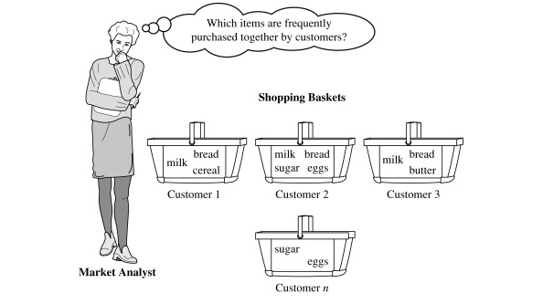
objective
To find frequently purchased item sets from large transactional database.

Slide 11
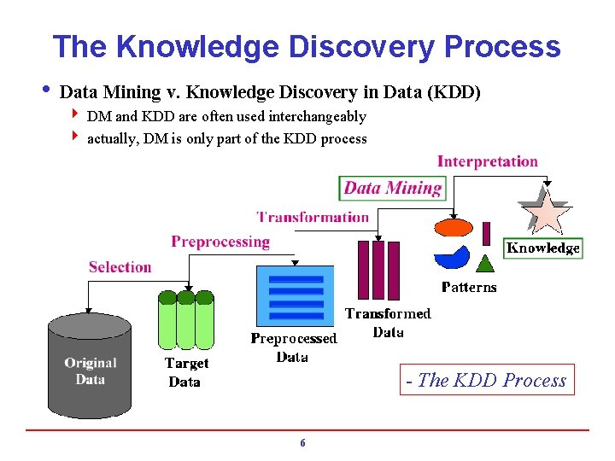

Slide 12
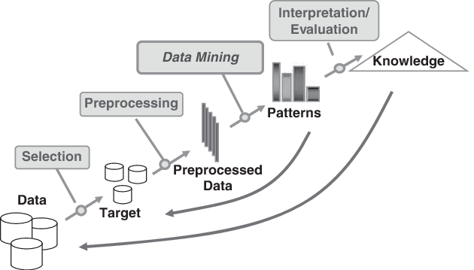

Slide 13
What is market basket?
The process of discovering frequent item sets in large transactional database is called market basket analysis.
Because 5 V(velocity, variety, volume, variability, veracity ) of big data we use machine learning in this.
Market Basket Analysis is a technique that is used to discover the association between items.
In simplest terms, it allows retailers to identify a relationship between items that generally people buy together.
This entire process and analysis are known as ‘Market Basket Analysis’ in terms of technology and data. It works on the idea that if a customer buys one item, they are bound to buy (or not buy) another related item or group of items.

Slide 14
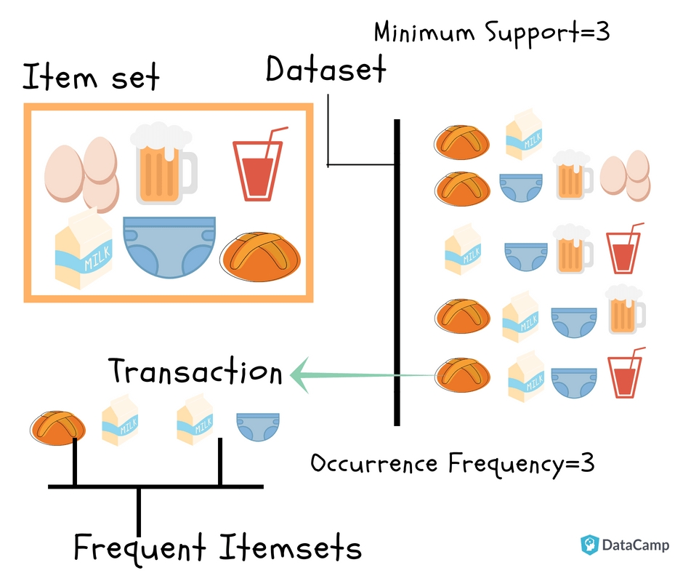

Slide 15
Association rule
Association Rule Mining is a rule-based machine learning method to find associations and relationships between large sets of items. This rule also shows how frequently an item occurs in the item set based on the occurrences of other items in a transaction.
The concept of association rule was popularised particularly due to the 1993 article of RAKESH AGRAWAL.
It is one of the most cited paper in the data mining field.
Association rules are widely used to analyze basket or transaction data to discover strong rules based on the frequency of occurrences. Association rules can be understood as the “if this, then that” rule.
For example, if a user buys coffee and sugar, then he/she is likely to buy milk.

Slide 16
.
This rule could be written as:
If {A} Then {B}
Here, If part of the rule is known as antecedent and THEN part of the rule is known as consequent. {A} part is the condition and {B} part is considered as the result.

Slide 17
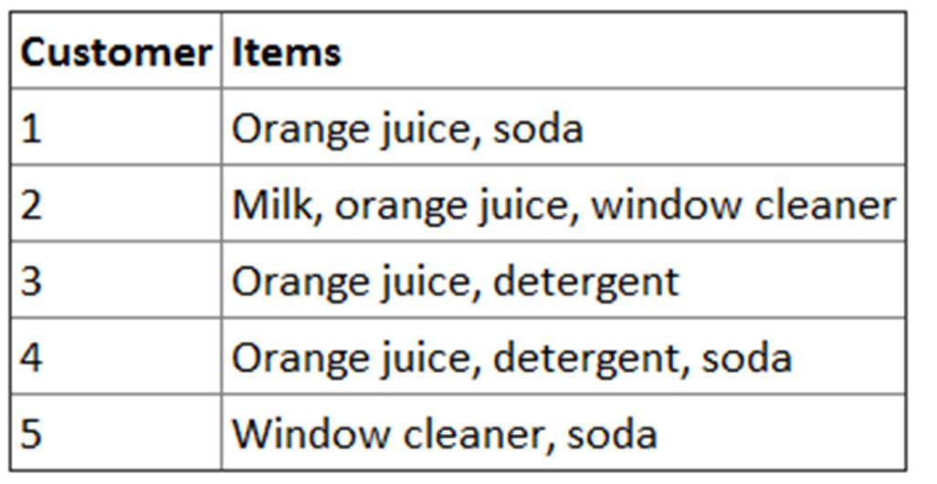
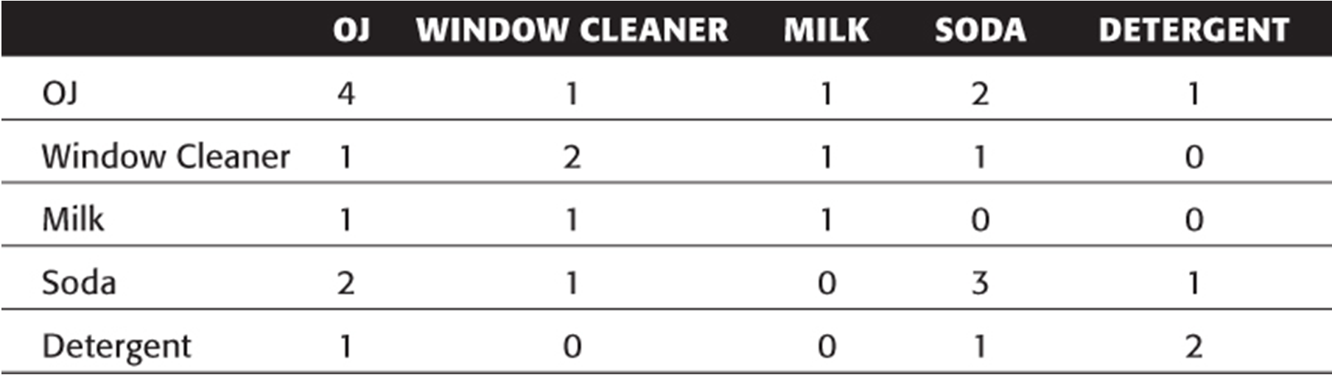
.
Orange juice and soda are more likely to be purchased together than any other
two items.
Detergent is never purchased with window cleaner or milk.
Milk is never purchased with soda or detergent.

Slide 18
.
A => B [ s, c ]
Support: denotes the frequency of the item(rule) within transactions.
A high value means that the rule involves a great part of database.
support(A =>B [ s, c ]) = p(A|B)
Confidence: denotes the percentage of transactions containing A
which also contain B. It is an estimation of conditioned probability .
confidence(A => B [ s, c ]) = p(B|A) = sup(A,B)/sup(A)
lift: This says how likely item 2 is purchased when item 1 is purchased, while controlling for how popular item 2 is.

Slide 19
Association rule type
Actionable Rules
contain high‐quality, actionable information
Trivial Rules
information already well‐known by those familiar with the business.

Slide 20
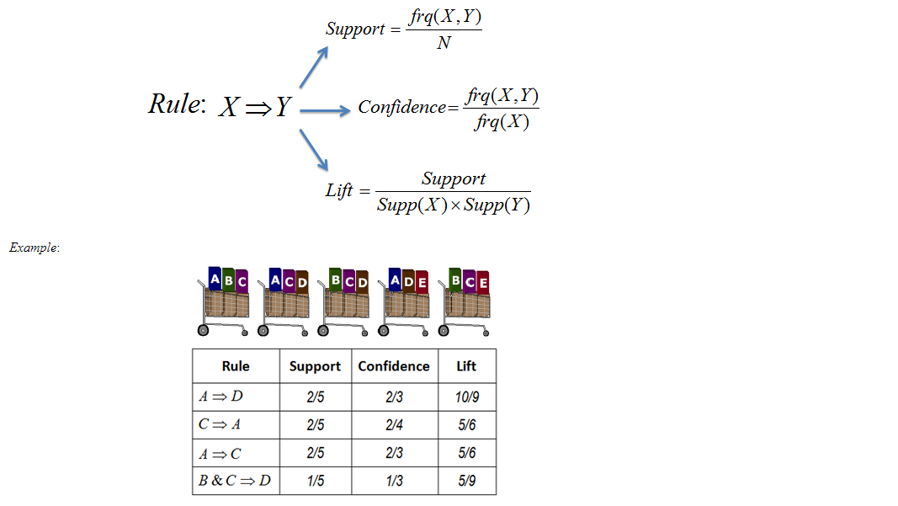
.
Example:1

Slide 21
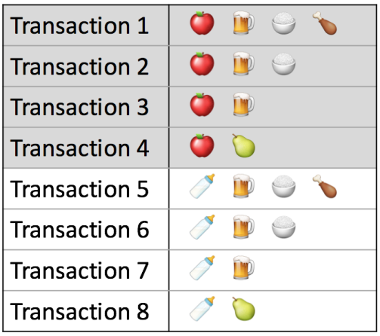



Example:2

Slide 22
An example of Association Rules
Assume there are 100 customers 10 of them bought milk, 8 bought butter and 6 bought both of them.
Answer
bought milk => bought butter
support = P(Milk & Butter) = 6/100 = 0.06
confidence = support/P(Butter)
= 0.06/0.08 = 0.75
lift = confidence/P(Milk) = 0.75/0.10 = 7.5

Slide 23
What is apriori algorithm
Apriori algorithm is the most established algorithm for finding frequent item set mining.
The basic principle of Apriori is “any subset of a frequent itemset must be frequent”.
We use these frequent itemsets to generate association rule.

Slide 24
Apriori algorithm
Ck: candidates itemset of size k
Lk: frequent itemsets of size k
L1={frequent items};
For(k=1; Lk!=0; k++)
Ck+1= candidates generated from Lk;
For each transaction t in the database do increment to count of all candidates in Ck+1 that are contained in t
Lk+1= candidates in Ck+1 with min_support
End
Return to UkLk

Slide 25
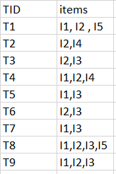
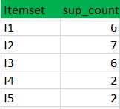
Before we start understanding the algorithm, go through some definitions which are explained in my previous algorithm Consider the following dataset and we will find frequent itemsets and generate association rules for them.
minimum support count is 2 minimum confidence is 60%
Step-1: K=1 (I) Create a table containing support count of each item present in dataset Called C1(candidate set)

Slide 26
(II) compare candidate set item’s support count with minimum support count (here min_support=2 if support count of candidate set items is less than min_support then remove those items).
This gives us itemset L1.
Step-2: K=2
Generate candidate set C2 using L1 (this is called join step). Condition of joining L_{k-1} and L_{k-1} is that it should have (K-2) elements in common.
Check all subsets of an itemset are frequent or not and if not frequent remove that itemset.(Example subset of{I1, I2} are {I1}, {I2} they are frequent. Check for each itemset)
Now find support count of these itemsets by searching in dataset.

Slide 27
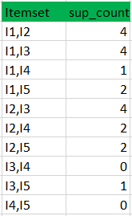
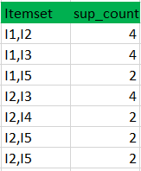
(II) compare candidate (C2) support count with minimum support count(here min_support=2 if support count of candidate set item is less than min_support then remove those items) this gives us itemset L2.

Slide 28

Step-3:
Generate candidate set C3 using L2 (join step). Condition of joining L_{k-1} and L_{k-1} is that it should have (K-2) elements in common. So here, for L2, first element should match.
So itemset generated by joining L2 is {I1, I2, I3}{I1, I2, I5}{I1, I3, i5}{I2, I3, I4}{I2, I4, I5}{I2, I3, I5}
Check if all subsets of these itemsets are frequent or not and if not, then remove that itemset.(Here subset of {I1, I2, I3} are {I1, I2},{I2, I3},{I1, I3} which are frequent. For {I2, I3, I4}, subset {I3, I4} is not frequent so remove it. Similarly check for every itemset)
find support count of these remaining itemset by searching in dataset.
II) Compare candidate (C3) support count with minimum support count(here min_support=2 if support_count of candidate set item is less than min_support then remove those items) this gives us itemset L3.

Slide 29
Step-4:
Generate candidate set C4 using L3 (join step). Condition of joining L_{k-1} and L_{k-1} (K=4) is that, they should have (K-2) elements in common. So here, for L3, first 2 elements (items) should match.
Check all subsets of these itemsets are frequent or not (Here itemset formed by joining L3 is {I1, I2, I3, I5} so its subset contains {I1, I3, I5}, which is not frequent). So no itemset in C4
We stop here because no frequent itemsets are found further
Confidence(A=>B)=Support_count(A∪B)/Support_count(A)
we will show the association rule generation . Itemset {I1, I2, I3} from L3 SO rules can be
[I1,I2]=>[I3] //confidence = sup(I1,I2,I3)/sup(I1,I2) = 2/4*100=50% [I1,I3]=>[I2] //confidence = sup(I1,I2,I3)/sup(I1,I3) = 2/4*100=50% [I2,I3]=>[I1] //confidence = sup(I1,I2,I3)/sup(I2,I3) = 2/4*100=50% [I1]=>[I2,I3] //confidence = sup(I1,I2,I3)/sup(I1) = 2/6*100=33% [I2]=>[I1,I3] //confidence = sup(I1,I2,I3)/sup(I2) = 2/7*100=28% [I3]=>[I1,I2] //confidence = sup(I1,I2,I3)/sup(I3) = 2/6*100=33%
So if minimum confidence is 50%, then first 3 rules can be considered as strong association rules.

Slide 30
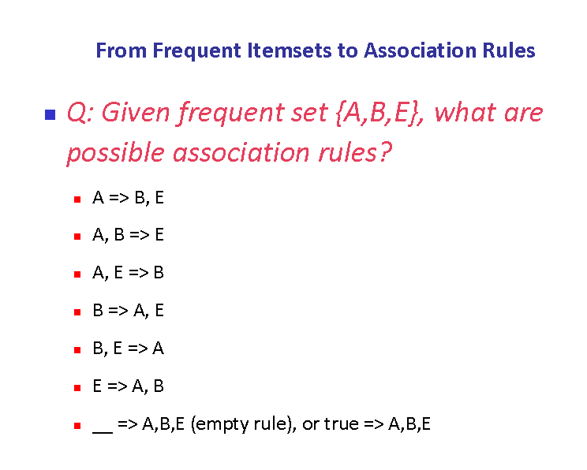

Slide 31
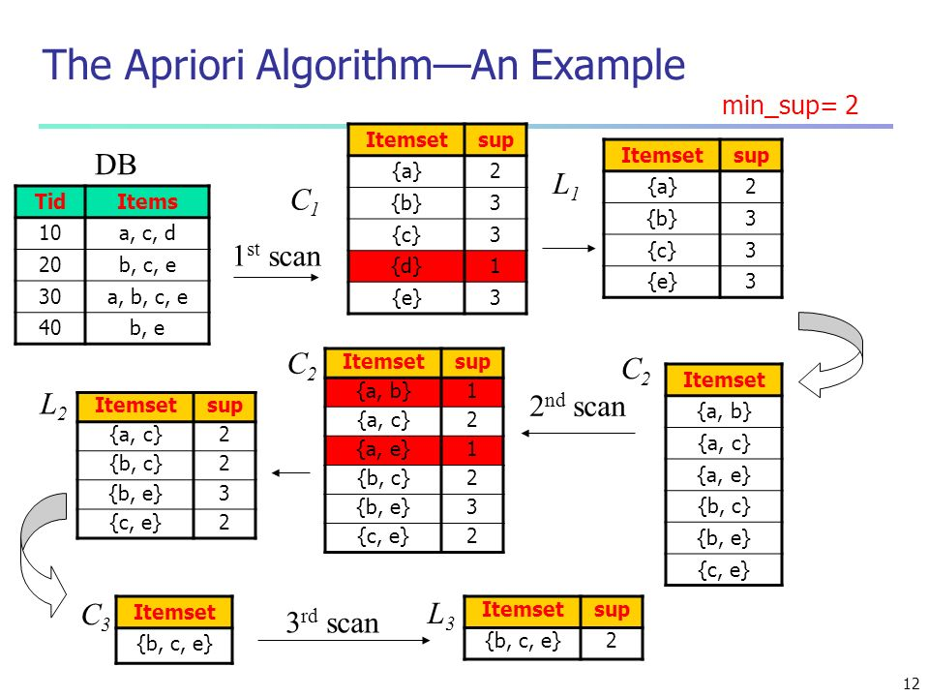

Slide 32
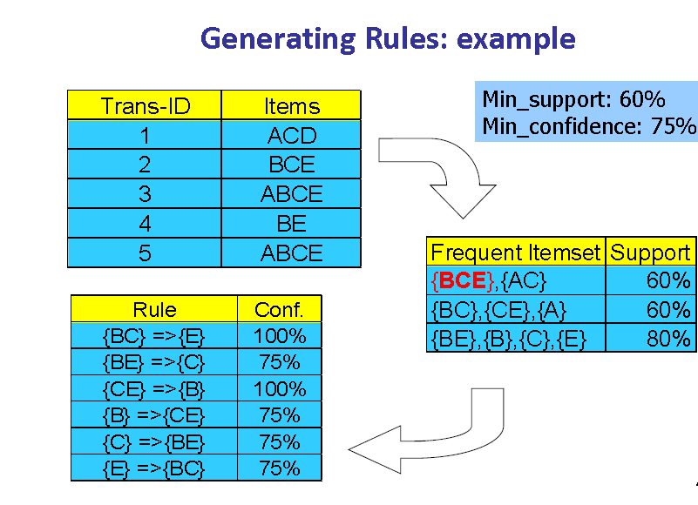

Slide 33
in the next diagram let’s know about how market basket analysis used in online marketing

Slide 34
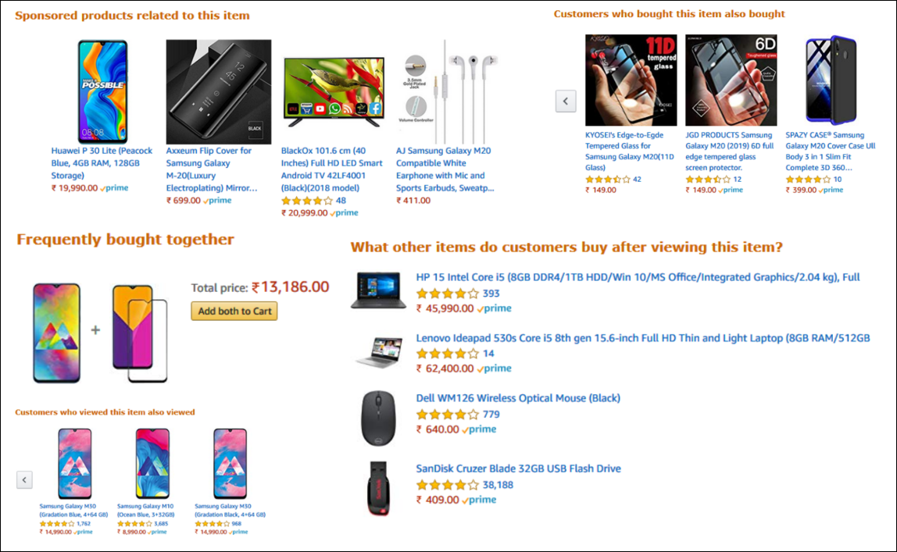

Slide 35
application
Proper placement of an item.
Fraud detection
Customer behavior.
affinity promotion.

Slide 36
summary
Market basket analysis
Discovering frequent item set.
Application of frequent item set.

Slide 37
reference
https://paginas.fe.up.pt
https://webfocusinfocenter.informationbuilders.com ›
https://towardsdatascience.com/
https://pbpython.com/

Slide 38
Thank you

Slide 39
Question?

